Slide 1
Implementation of a Modified LSB Steganography for Embedding Data in Various File Formats

Slide 2
TEAM MEMBERS
NAME | REGISTRATION NO
Areeb | 20BKT0045
Kartik Malik | 20BCE0477
Rahulkumar Ankola | 20BCE0530
Aditi Akhauri | 20BCI0125

Slide 3
OBJECTIVE
To hide secret message of either textual or image format within a cover-media of various file formats and extract it in such a way that others cannot discern the presence of the hidden message with the help of a modified LSB Steganography technique.

Slide 4
INTRODUCTION
The Least Significant Bit Steganography or simply the LSB technique is one of the oldest and simplest techniques implemented in the spatial domain that makes use of least significant bits of the original image pixels and replaces it with some secret bits (watermark values).
However, despite of its simplicity, the classical LSB technique is very much exposed to various statistical analysis . A modification in the algorithm of the standard LSB technique is required.
Therefore, we have introduced a modification in the existing technique by using multiple bits for embedding the secret data with the original image so that it becomes difficult for the attacker to extract the message.

Slide 5
APPLICATIONS
1) The advantages of Least-Significant-Bit (LSB) steganographic data embedding are that it is simple to understand, easy to implement, and it results in stego-images that contain hidden data yet appear to be of high visual fidelity. Currently, the most common usage of steganography is to hide one computer file inside of another computer file.
2) A practical steganographic implementation for 8-bit images enabled smaller file sizes to be utilized in steganographic communications. While also limiting the size of the hidden file, this implementation addressed issues that have been passed by in other applications, and provided a more compact vehicle for those secret communications that do not require a large cover-file.
3) Today steganography is being incorporated into digital technology. The techniques have been used to create the watermarks that are in our nation’s currency, as well as encode music information in the ever-popular mp3 music file. Copyrights can be included in files, and fingerprints can be used to identify the people who break copyright agreements.

Slide 6
4) Since BMP uses lossless compression, LSB makes use of BMP image. To be able to hide a secret message inside a BMP file, one would require a very large cover image. BMP images of 800×600 pixels found to have less web applications. Moreover such uses are not accepted as valid. For this reason, LSB Steganography has also been developed for use with other image file formats. One can see that there exists a large selection of approaches to hiding information in images using various image steganographic techniques.
5) All the major image file formats have different methods of hiding messages, with different strong and weak points respectively. LSB in GIF images has the potential of hiding a large message, but only when the most suitable cover image has been chosen.
6)LSB is used in image analysis:
A.LSB in BMP
B.LSB in PNG
C.LSB in GIF

Slide 7
LITERATURE REVIEW
SERIAL NO. | AUTHOR | YEAR OF PUBLISHING | TITLE | METHODOLOGY | METRICS | DRAWBACKS
1. | V. Lokeswara Reddy, Dr. A. Subramanyam, Dr. P. Chenna Reddy | 2010 | Implementation of LSB Steganography and its evaluation for various File Formats | · The Objective of this study is to implement Least Significant Bit Steganography on various file formats. · The original image and the image to be hidden is read and the image to be hidden is shifted by x bits. · | Mean-Squared Error (MSE). Peak Signal-to-Noise Ratio Steganalysis Detection Payload Capacity Independence of the file format Perceptibility | · It is vulnerable to steganalysis and hence not secure at all. Has low-security since in this, the watermark is embedded into single bit of original message only.

Slide 8
LITERATURE REVIEW
SERIAL NO. | AUTHOR | YEAR OF PUBLISHING | TITLE | METHODOLOGY | METRICS | DRAWBACKS
 |  |  |  | · The MSB of the cover image is set according to the image. The no. of LSB’s to be considered accordingly. The shifted hidden image and the result from the previous step is bitored which only makes changes in the original image. | Percentage Distortion less resultant image
2. | Nan-I-Wu, Min-Shiang Hwang | 2017 | A novel LSB data Hiding scheme with the lowest distortion | During encoding of the data, 3 secret bits are embedded in three pixels of the original image. | Peak Signal-to-Noise Ratio Mean-Squared Error | The method is comparatively complex.

Slide 9
LITERATURE REVIEW
SERIAL NO. | AUTHOR | YEAR OF PUBLISHING | TITLE | METHODOLOGY | METRICS | DRAWBACKS
 |  |  |  | · The XOR operation is performed between the least significant bits of the original image. The pixels are then adjusted after comparing the XOR values with secret bit values. | No.of pixels with overflow and underflow conditions. K-Parameter Payload Capacity RS Analysis Expected no. of modification per pixel (ENMPP) | This technique successfully survives the statistical RS attack. However, low hiding capacity remains the major issue for this technique as it only hides 1 bit in each pixel of the cover/original image.

Slide 10
LITERATURE REVIEW
SERIAL NO. | AUTHOR | YEAR OF PUBLISHING | TITLE | METHODOLOGY | METRICS | DRAWBACKS
3. | Firas A. Jassim, Hind E. Qassim | 2012 | Five Modulus Method for Image Compression | · The cover image is divided into N blocks of block size k*k pixels, where ‘K’ is the size of window. Then each pixel in the blocks is modified such that the pixel of block is divisible by 5. | Peak Signal to Noise Ratio (PSNR). Mean Squared Error (MSE) Compression Ratio (CR) Root Mean Square Error (RMSE) | The limitation of this method is the hiding capacity, being below 1 bit per pixel in some cases.

Slide 11
LITERATURE REVIEW
SERIAL NO. | AUTHOR | YEAR OF PUBLISHING | TITLE | METHODOLOGY | METRICS | DRAWBACKS
4. | S. Batra, R. Rishi | 2010 | Insertion of the message in 6th ,7th and 8th bit of pixel values and retrieval in case intruder changes the least significant bit of image pixels. | · A pseudo random location(l) in the cover object using secret key is found for inserting the message bit b and then we check for the pixel value at the location. After this, the 6th ,7th and 8th bits at the location are checked. | Histogram Analysis Mean Squared Error (MSE) Peak Signal-to Noise Ratio (PSNR) | This method does not provide 100 % message insertion rate.

Slide 12
System Design

Slide 13
Algorithm for LSB Embedding
(Text Files)
Take input of text that is to be hidden and create a function to convert the text to binary format.
For the conversion of the text to binary digits , 8 bit representation of the text is taken into account.
Input the image in any file format where you wish to embed your message.
Perform the XOR condition between the 2nd LSB of each pixel (cover image) and bits of message.
Replace the resultant with the LSB of the cover image.
Repeat step 4 and 5 for every pixel (red green blue) of the cover image.
And the data is embedded on the cover image.
For retrieving the message from the embedded image, perform the XOR condition between the LSB and 2nd LSB of the image. The resultant is the bit of secret message encoded.
Repeat step 8 for every pixel until the message is encoded.

Slide 14
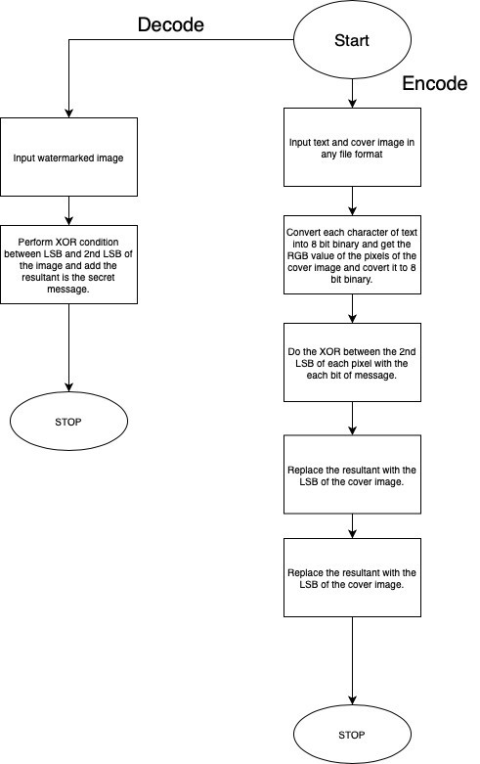
Flowchart for LSB Embedding
(Text file)

Slide 15
Flowchart for LSB Embedding
(Text file)

Slide 16
Algorithm for LSB Embedding
(Image Files)
Input original image in any format.
Input watermark in any File format.
Resize the watermark according to original image.
Merge the first 6 bits of the original image and first 2 bits of the watermark image.
Get watermarked image.
To decode the embedded image from the watermark image, take the last two bits of the watermarked image and add six zeros to it. (So that it will be a 8 bit pixel and adding zeros will increase the brightness of the image).
Calculate PSNR and MSE value of watermarked image.
Similarly,
We can merge any amount of bits adding upto 8, where bits of original image >= bits in watermarked image, for example, merging 4 bits of watermarked image and 4 bits of original image.

Slide 17
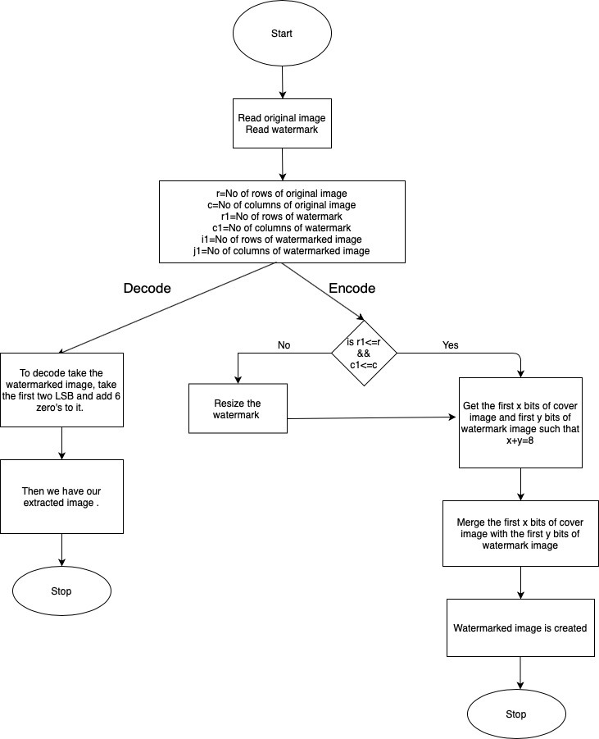
Flowchart for LSB Embedding
(Image file)

Slide 18
Flowchart for LSB Embedding
(Image file)

Slide 19
Implementation Example
Text and Image Embedding

Slide 20
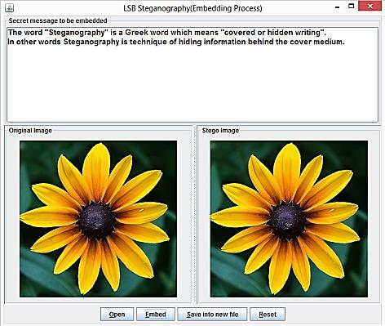
Hiding Text in Cover Image

Slide 21
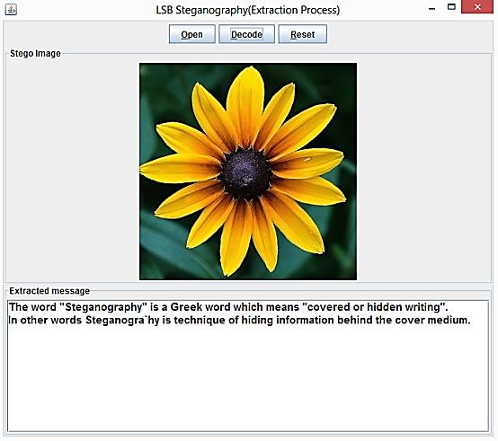
Extracting Secret Message

Slide 22
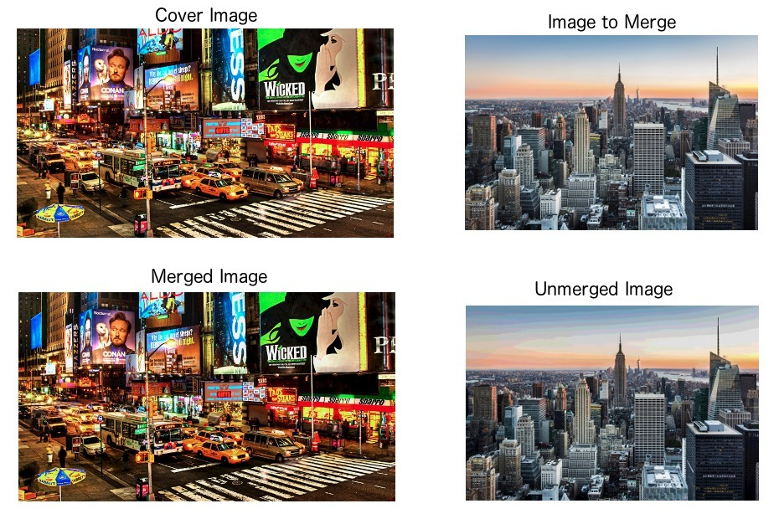
Image Embedding

Slide 23

—
EVALUATION METRICS
For comparing stego image with cover results requires a measure of image quality, commonly used measures are Mean-Squared Error, Peak Signal-to-Noise Ratio and histogram.
A. Mean-Squared Error :- The mean-squared error (MSE) between two images I1(m,n) and I2(m,n) is:
M and N are the number of rows and columns in the input images, respectively. Mean-squared error depends strongly on the image intensity scaling. A mean-squared error of 100.0 for an 8-bit image (with pixel values in the range 0-255) looks dreadful; but a MSE of 100.0 for a 10- bit image (pixel values in [0,1023]) is barely noticeable.

Slide 24

B. Peak Signal-to-Noise Ratio:-Peak Signal-to-Noise Ratio (PSNR) avoids this problem by scaling the MSE according to the image range
PSNR is measured in decibels (dB). PSNR is a good measure for comparing restoration results for the same image, but between-image comparisons of PSNR are meaningless.
EVALUATION OF DIFFERENT TECHNIQUES:
Comparison of LSB technique for various file formats is shown in the below table:

Slide 25
 | LSB IN BMP | LSB IN GIF | LSB IN PNG
Percentage Distortion less resultant image | High | Medium | Medium
Invisibility | High | Medium | Medium
Steganalysis detection | Low | Low | Low
Image manipulation | Low | Low | Low
Amount of embedded data | High | Medium | Medium
Payload capacity | High | Medium | Medium
Independent of file format | Low | Low | High

Slide 26
DATABASE
Database for samples used is taken from the following sites:
For text on image steganography : https://www.researchgate.net/figure/Steganography-Layer-Extraction-Process_fig3_286480376
For image on image steganography :https://towardsdatascience.com/steganography-hiding-an-image-inside-another-77ca66b2acb1
There is no database for the code as the user will have to choose the cover image and the text/image to be embedded on the cover image. .

Slide 27
PLATFORM FOR IMPLEMENTATION
IDE : Visual Studio Code
Programming Languages :
Python (OpenCV, Numpy and Flask)
HTML
CSS
JavaScript

Slide 28
CONTRIBUTION
SERIAL NO. | TEAM MEMBER | Contribution
1. | Areeb | Documentation Code Testing Quality Measures
2. | Kartik Malik | Documentation Website coding Research Code Testing
3. | Rahulkumar Ankola | Documentation Coding + Backend Research Robustness, Quality Measures
4. | Aditi Akhauri | Documentation Coding Research Robustness, Quality Measures

Slide 29
References
[1] V. Lokeswara Reddy, Dr. A. Subramanyam, Dr. P. Chenna Reddy, 2011, “Implementation of LSB Steganography and its Evaluation for various File Formats”, Int J. Advanced Networking and Applications Volume: 02, Issue: 05, Pages: 868-872
[2] Nan-I Wu, Min-Shiang Hwang, 2017, “A Novel LSB Data Hiding Scheme with the Lowest Distortion”, Imaging Science Journal, Vol.65, Issue: 6, Pages: 371-378.8p.
[3] Firas A. Jassim, Hind E. Qassim, 2013, “Five Modulus Method for Image Compression”, Signal & Image Processing: An International Journal (SIPIJ), Vol.3, No. 5.
[4] Sudhir Batra, Rahul Rishi and Rajkumar, 2010, “Insertion of message in 6th, 7th and 8th bit of pixel values and its retrieval in case intruder changes the least significant bit of image pixels”, International Journal of Security and Its Applications Vol. 4, No. 3.
[5] Touhid Bhuiyan, Afjal H. Sarower, Md. Rashed Karim, Md. Maruf Hassan, 2019, “An Image Steganography Algorithm using LSB Replacement through XOR Substitution”, 2019 International Conference on Information and Communications Technology (ICOIACT), 44-49.

Slide 30
[6] Jessica Fridrich, Miroslav Goljan, Rui Du, 2001, “Reliable detection of LSB steganography in color and grayscale images”, Multimedia and security: new challenges, 27-30.
[7] Nadeem Akhtar, Pragati Johri, Shahbaaz Khan, 2013, “Enhancing the security and quality of LSB based image steganography”, International Conference and Computational Intelligence and Communication Networks, 385-390.
[8] Shamim Ahmed Laksar, Kattamanchi Hemachandran, 2012, “Hiding Capacity data hiding using LSB Steganography and Encryption”, International Journal of Database Management Systems 4(6), 57.
[9] Mamta Juneja, Parvinder S Sandhu, Ekta Walia, 2009, “Application of LSB based steganographic technique for 8-bit color images”, World Academy of Science, Engineering and Technology 50, 423-425.
[10] Mohammed Mahdi Hashim, Mohd. Shafry Rahim, Fadil Abass Johi, Mustafa Sabah Taha, Hassan Salman Hamad, 2018, “Performance evaluation measurement of image steganography techniques with analysis of LSB based on variation images formats”, International Journal of Engineering & Technology, 7(4) (2018) 3505-3514.
[11] Mahbuba Begum, Mohammad Shorif Uddin, 2020, “Analysis of Digital Image Watermarking Techniques through Hybrid Methods”, Advances in Multimedia, Volume 2020, Article ID 7912690, 12 pages.

Slide 31
Thank You

